Slide 1
Sensor Pod Configuration at TFRI with PRIME Week 4
Thaddeus Trinh
July 24, 2013

Slide 2
Proposed Research
To work with TFRI to help integrate new sensors into their Android sensor pod network and to deploy and test the new sensors in the field
Fuel Moisture Sensor
Solar Irradiation Sensor
Soil Moisture Sensor
Soil Drainage Gauge

Slide 3
Progress (Week 4)
Successfully integrated and tested the 10HS Soil Moisture Sensor
Identified additional components required for a full hardware installation of the Fuel Moisture Sensor and the CTD Sensor

Slide 4
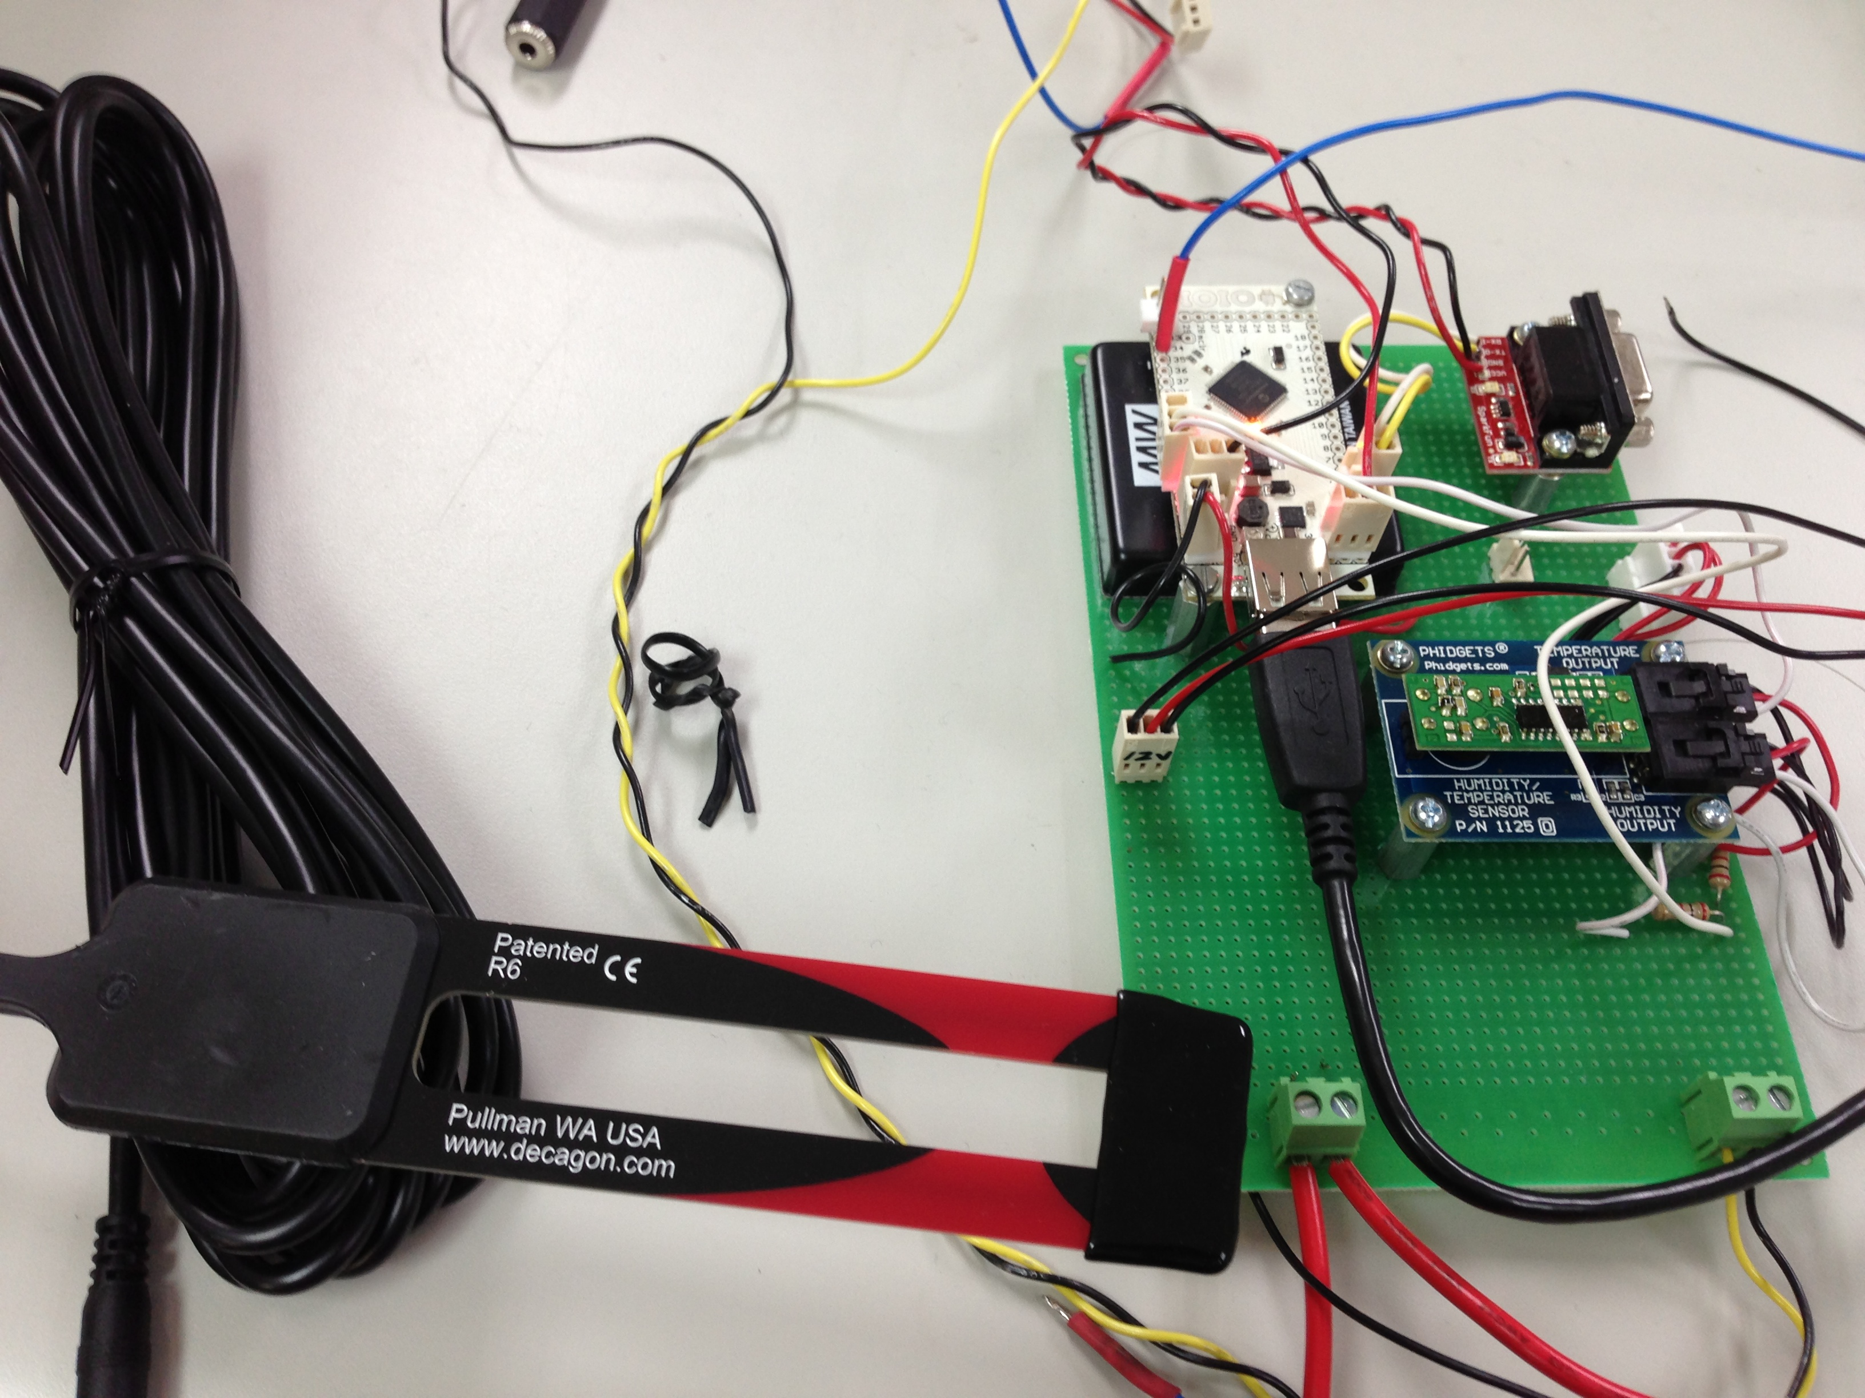
10HS Soil Moisture Sensor
The Soil Moisture Sensor is used to measure the volumetric water content of soil by rapidly charing and discharging a capacitor
I was able to finish editing the code to collect and send data from the Android phone to a local data turbine server

Slide 5
Fuel Moisture Sensor
One last obstacle with the Fuel Moisture Sensor
The fuel moisture content is calculated using both the fuel stick humidity and fuel stick temperature
Fuel stick temperature output is a thermistor
To convert the resistance into Celsius requires us converting to voltage with a constant current, outputting that voltage to the IOIO board, using an equation to calculate resistance, and putting that resistance into the Steinhart-hart equation to calculate Celsius

Slide 6
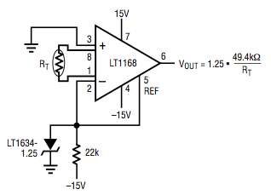
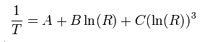
The LT1168 IC for calculating resistance and the Steinhart-hart equation for calculating current

Slide 7
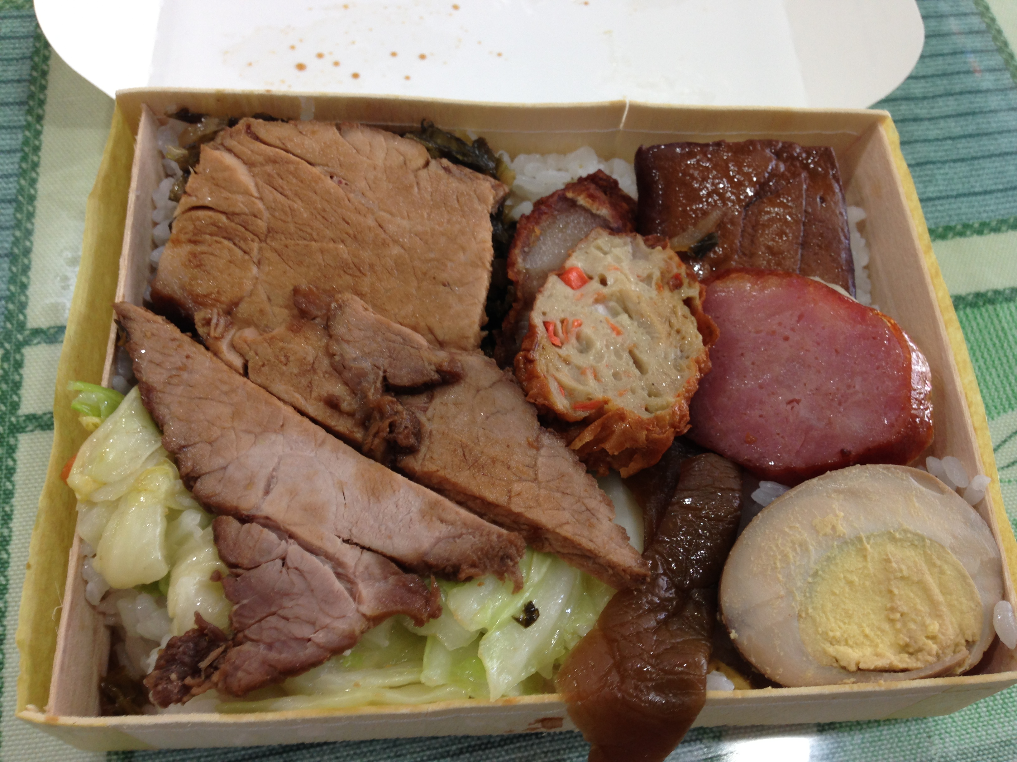
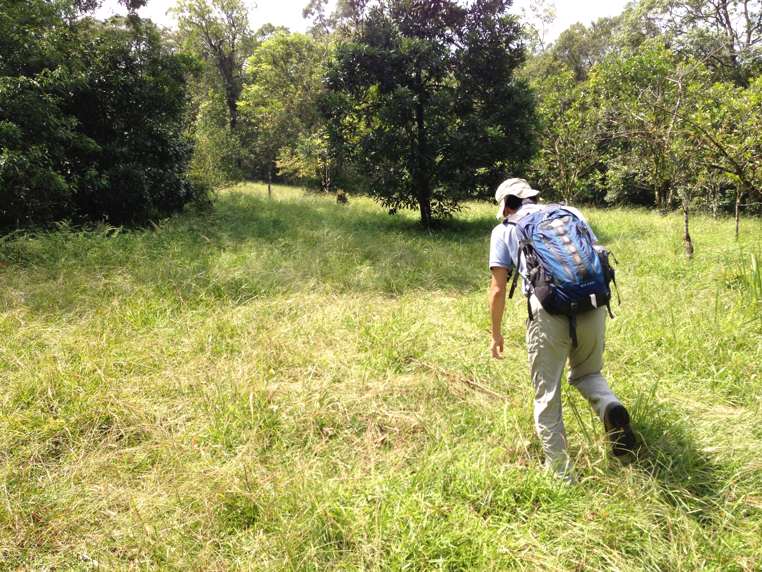


Culture
A three dollar bian dan (bento box), hiking through the forest with Dr. Wang, some grass pandas at the Taipei zoo, hiking through the hot and humid Zhinan temple

Slide 8
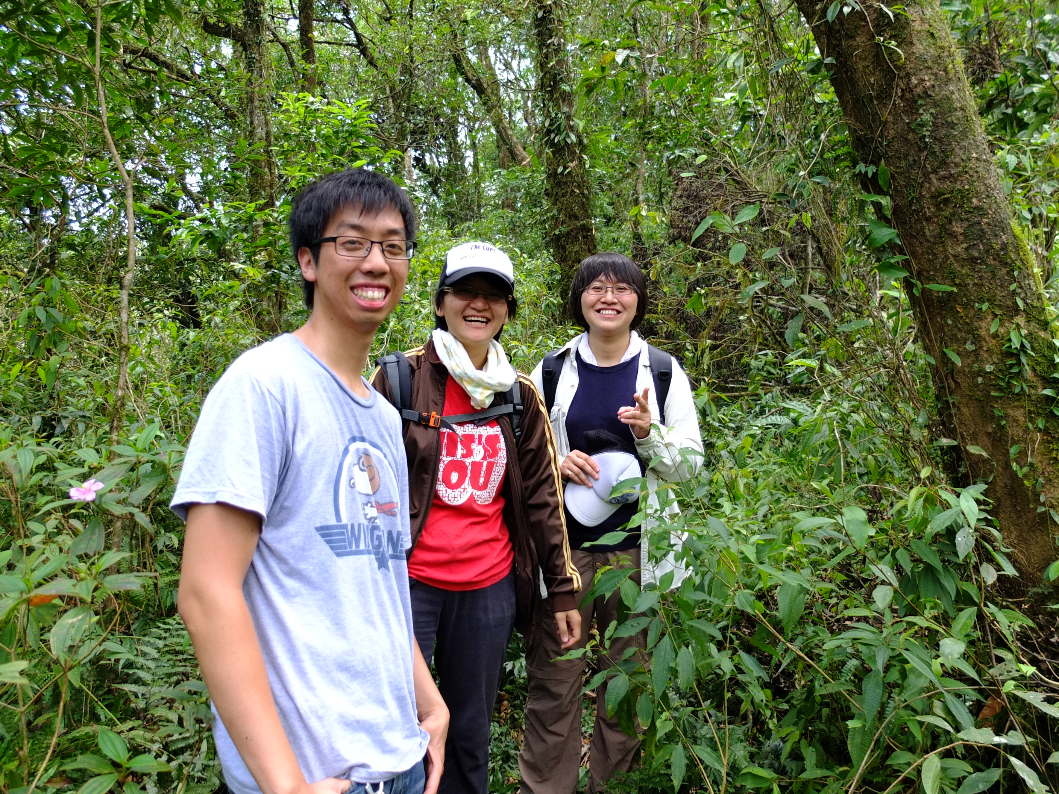
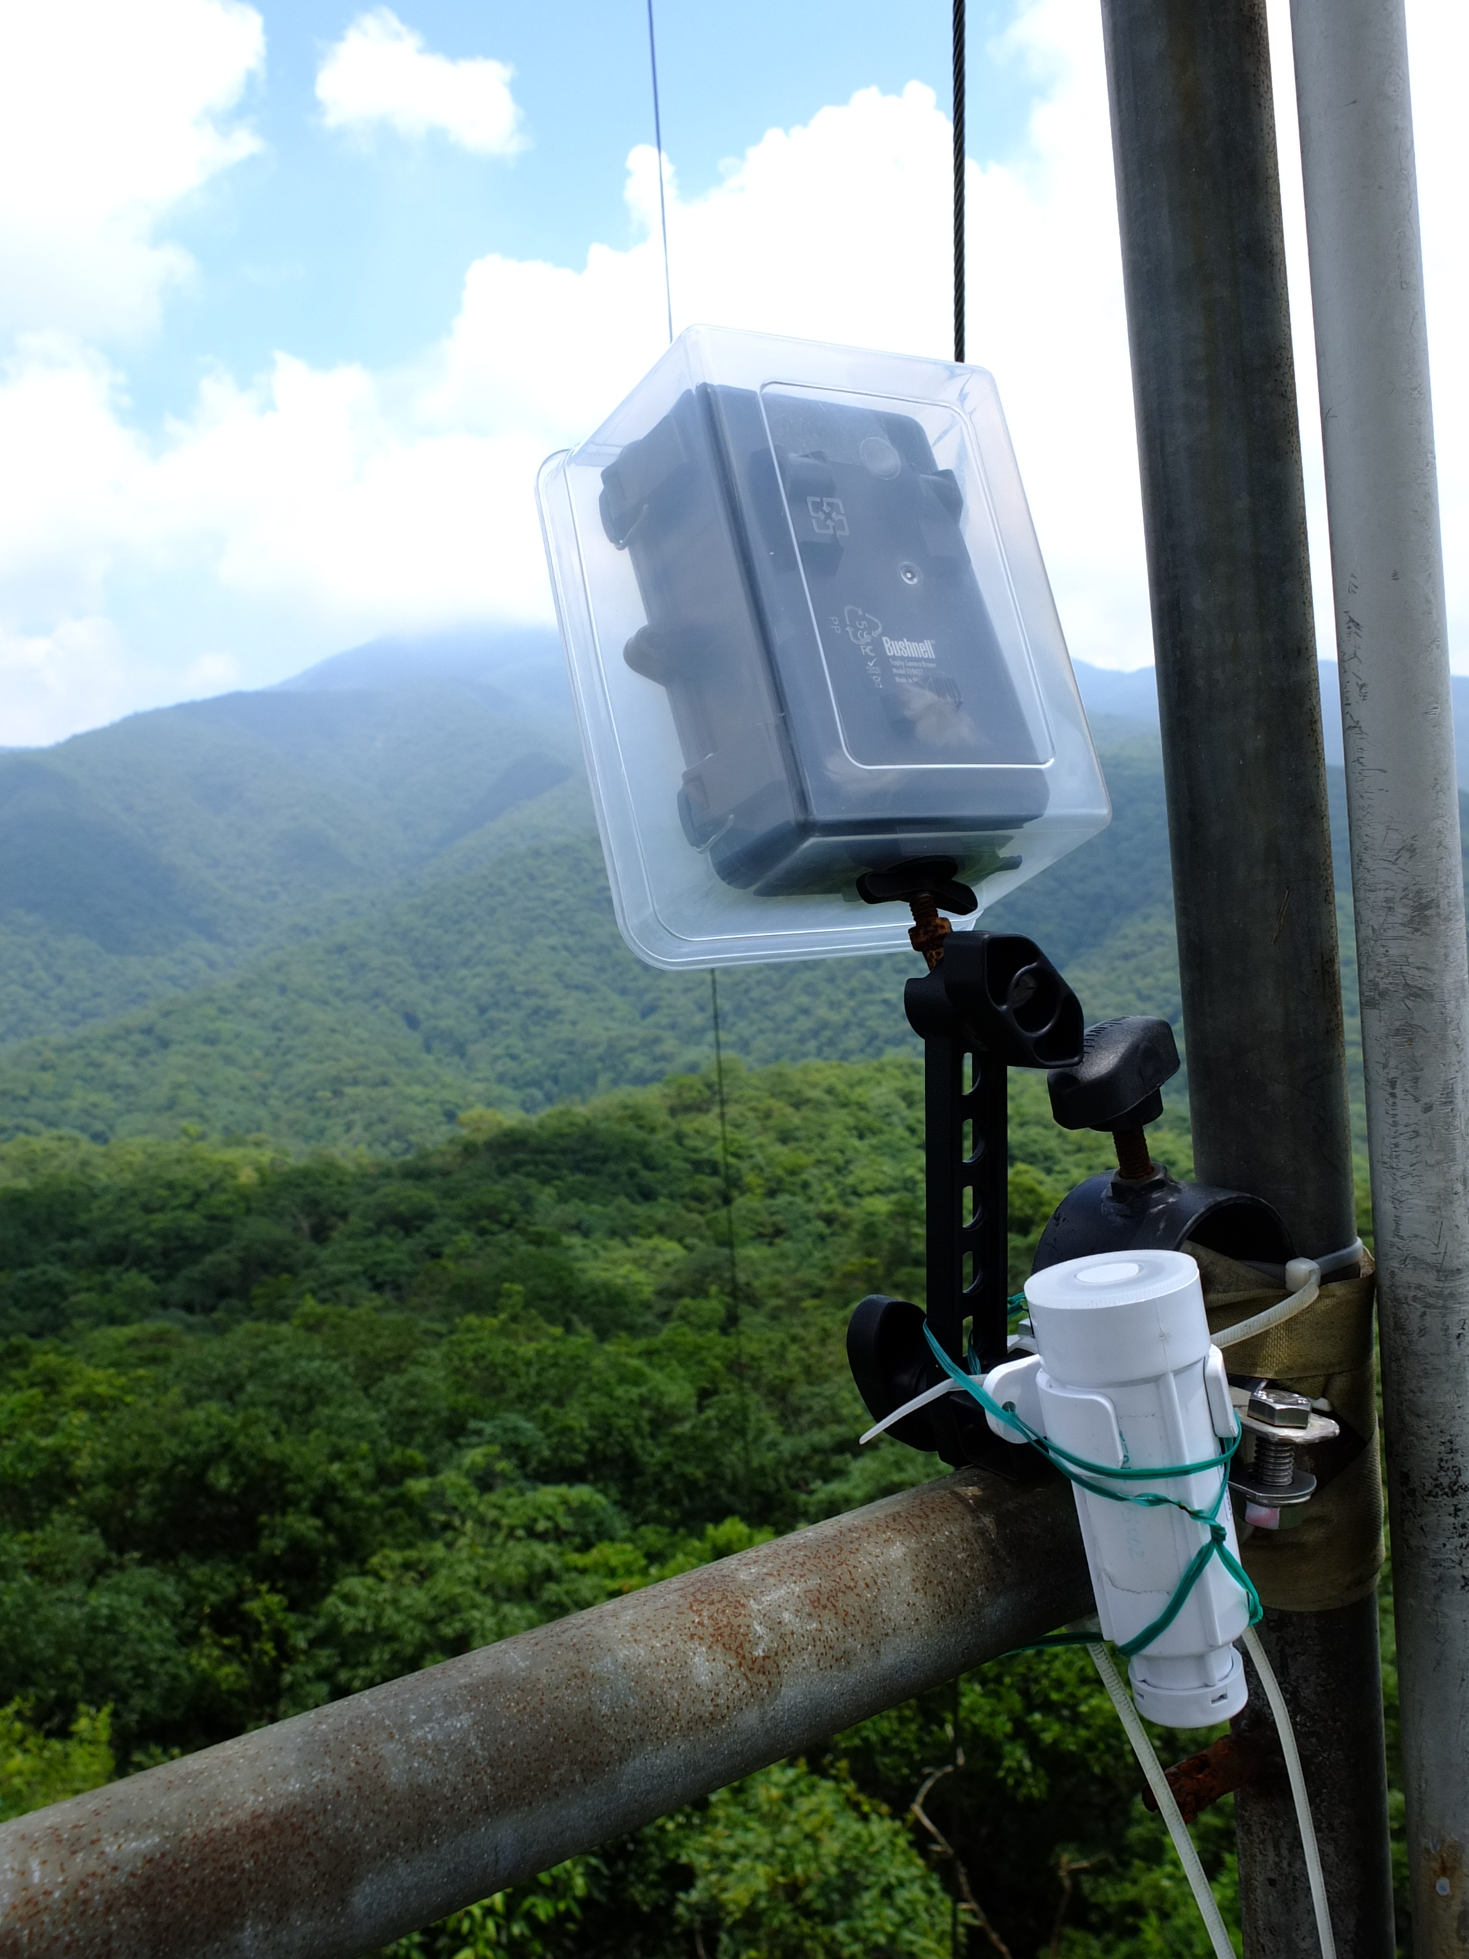
Hiking through Fushan to set up Cameras

Slide 9
Acknowledgements
Mentors
Tony Fountain (CALIT2)
Chau Chin Lin (TFRI)
Sheng-Shan Lu (TFRI)
Yu-Huang Wang (TFRI)
Peter Shin (CALIT2)
PRIME
Peter Arzberger
Gabriele Wienhausen
Teri Simas
Tricia Taylor

